Slide 1
Who makes your country famous?
УМК “English – 9”. В.П. Кузовлев, Н.М. Лапа и др.

Slide 2
WARMING UP
Charles Dickens
Rolling Stones
Winston Churchill
William Shakespeare
Beatles
Isaac Newton
Margaret Thatcher
Elton John
Sting
Tony Blair
Princess Diana
Agatha Christie
Michael Faraday
Alexander Bell
J.R.R. Tolkien
Charles Darwin

Slide 3
WORD BUILDING
Verbs | Nouns
discover | Discovery
develop | Development
achieve | Achievement
investigate | Investigation
succeed | Success
invent | Invention
create | Creation
explore | Exploration
design | design
research | research

Slide 4
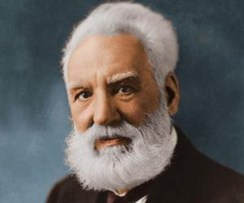
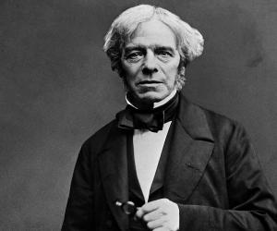
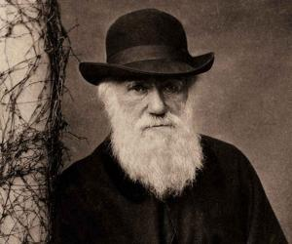
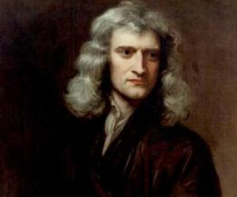
THE BOARD OF FAME
- was an English physicist and
mathematician, formulated
the laws of motion and
universal gravitation
was an English scientist who
contributed to the fields of
electromagnetism and
electrochemistry.
- was a Scottish-born scientist,
inventor, engineer and
innovator who is credited
with patenting the first
practical telephone.
was an English naturalist
and geologist, best known for
his contributions to evolutionary
theory.

Slide 5
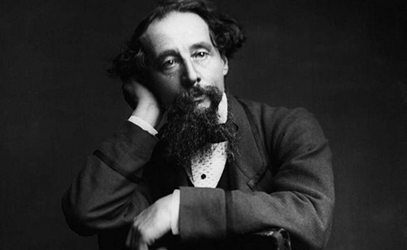
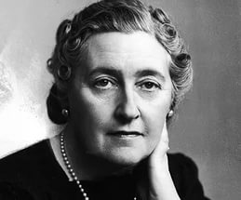
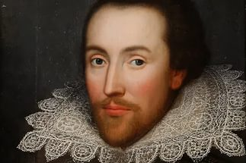
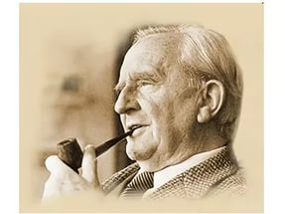
- was an English writer, poet, philologist,
and university professor who is best
known as the author of the classic
high-fantasy works The Hobbit,
The Lord of the Rings.
was an English writer and social critic.
And the author of Oliver Twist.
was an English crime novelist, short
story writer and playwright.
was an English poet, playwright,
and actor, is often called England's
national poet, and the "Bard of Avon".

Slide 6
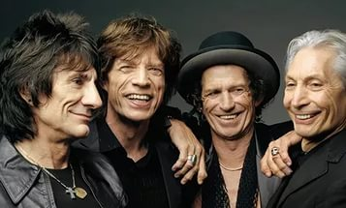
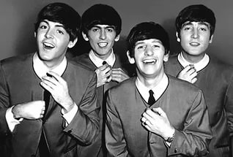
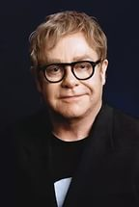
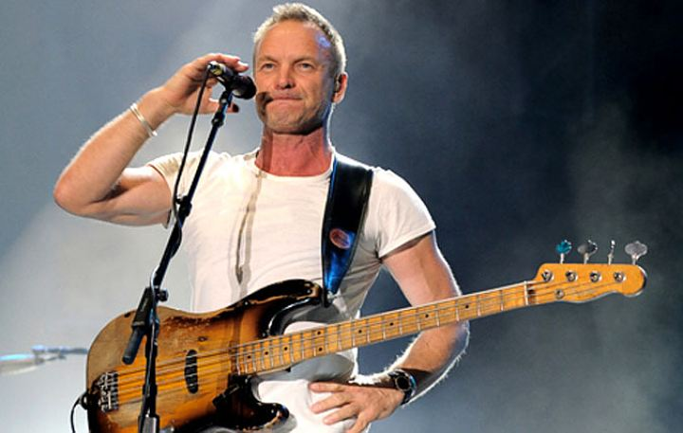
…is an English musician, singer, songwriter, multi-instrumentalist, activist, actor, and
philanthropist. … has received 16 Grammy Awards.
… is an English singer,
songwriter, and composer…
has received six Grammy Awards
And many others.
…were an English rock band,
formed in Liverpool in 1960.
…are an English rock band
formed in London in 1962.

Slide 7
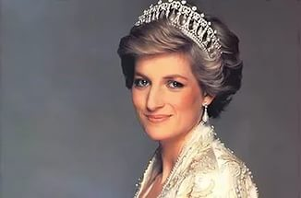
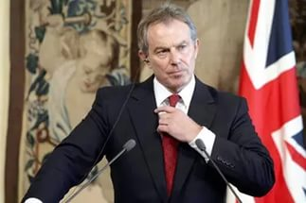
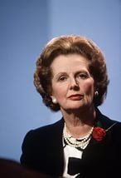
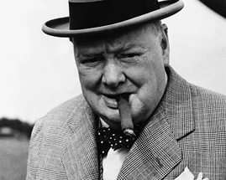
… was the first wife of Charles, Prince of Wales.
… is a British politician, who servedas the Prime Minister of the United Kingdom (UK).
…was the Prime Minister of the United Kingdom from 1979 to 1990.
… was the Prime Minister of the United Kingdom from 1940 to 1945.

Slide 8
Goodbye!

