Slide 1
Project «Life in this country 50 years ago»
Made by:Bibikova Arina

Slide 2
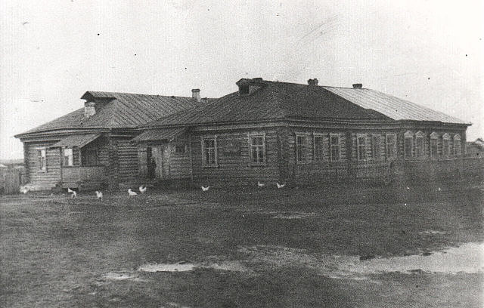
Our school 50 years ago
It was a wood building . It was one- storied house. The school was big and long. There were 400 pupils here. The head of school was V. I. Zhestkov.

Slide 3
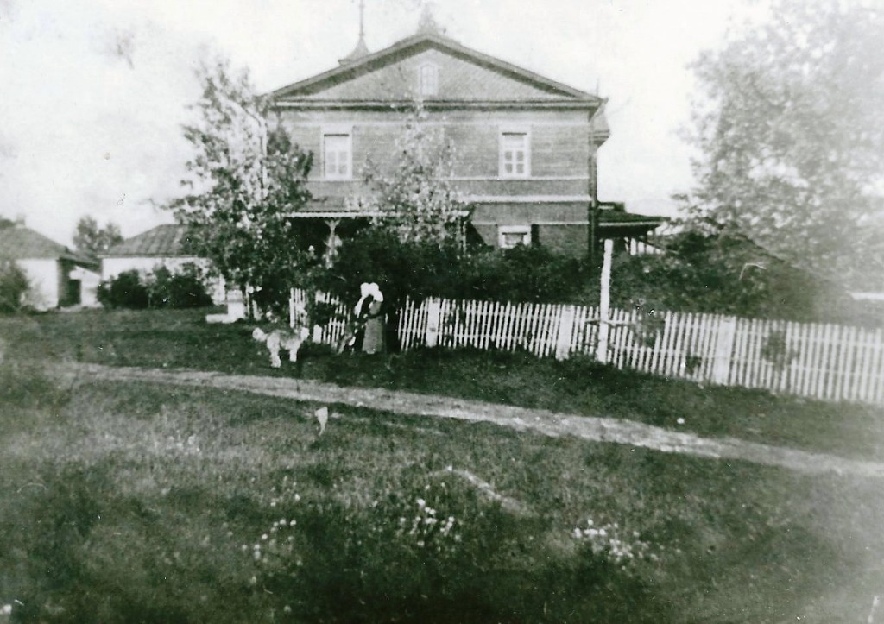
The house of the local landowner
The house of a local landowner Manaseihi was between the village of Yanovo and Chufarovo

Slide 4
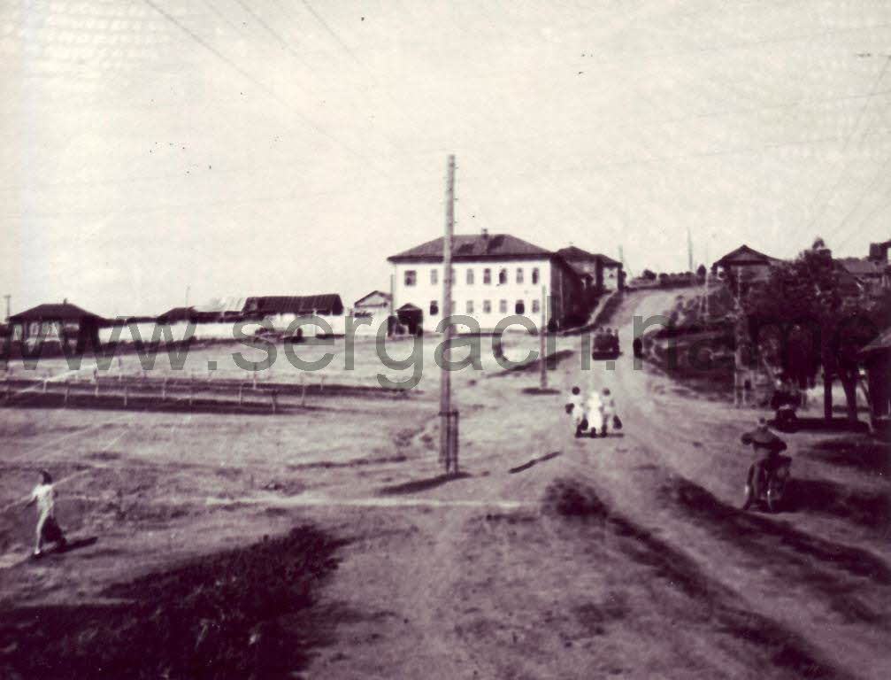
It is a Military Commissariat in the city of Sergach

Slide 5
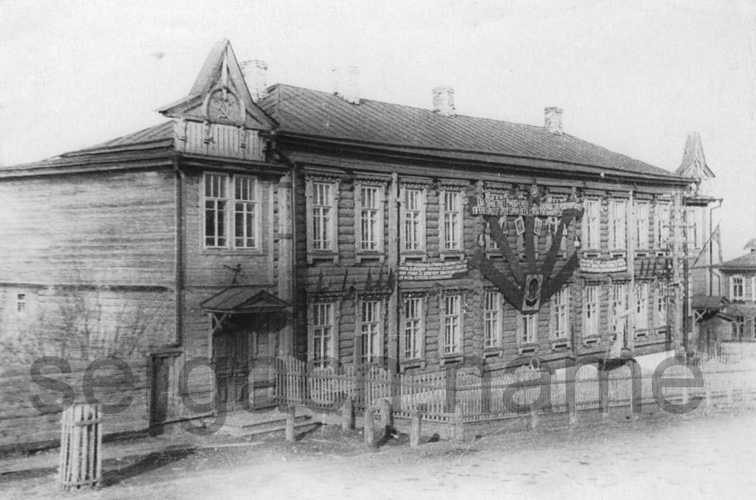
This is a committee of the party in the city of Sergach

Slide 6
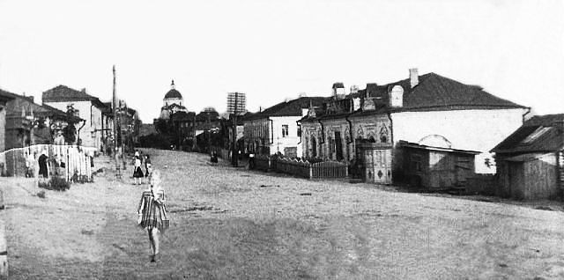
There were the building of the shop "Spar" and the building of the Department of education in the Sovetskaya.

Slide 7
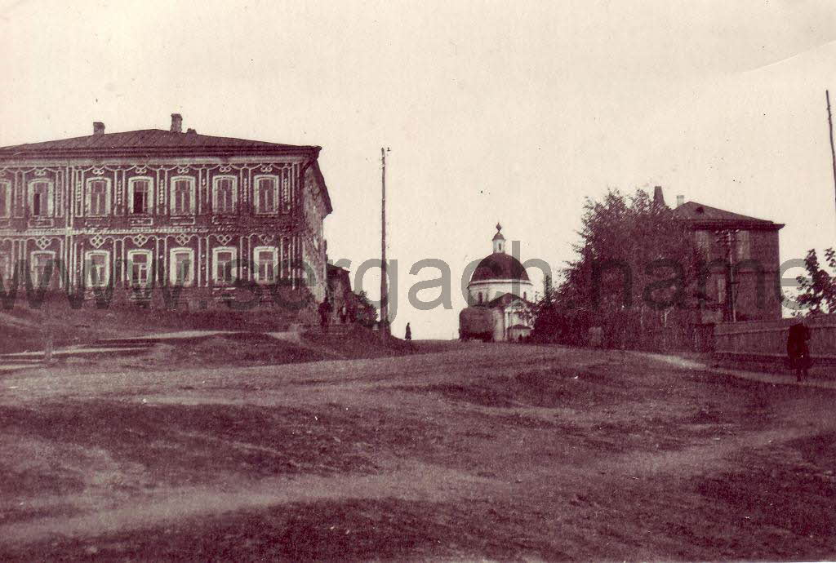
The house of culture in the city of Sergach
Often there were concerts. Now this place is very popular. Here show a variety show.

Slide 8
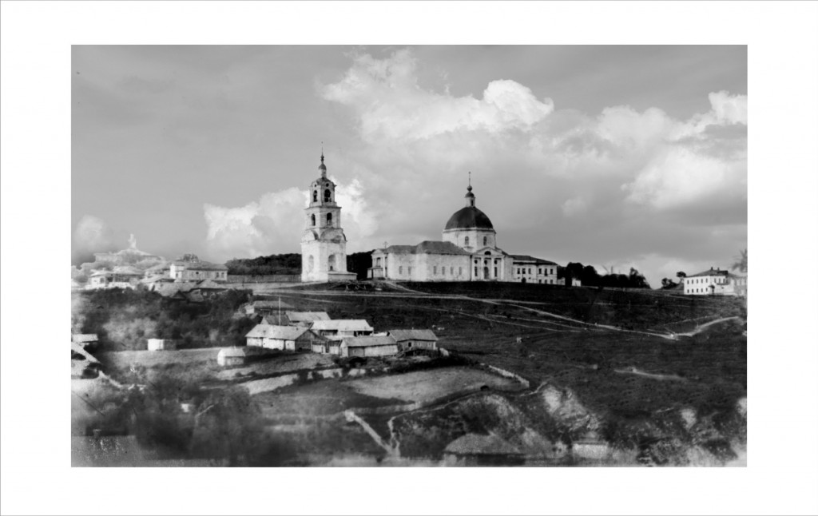
Vladimirskiy Cathedral in the city of Sergach

