Slide 1
Bibikova Ksenia 2017
Project
«My favourite clothes»

Slide 2
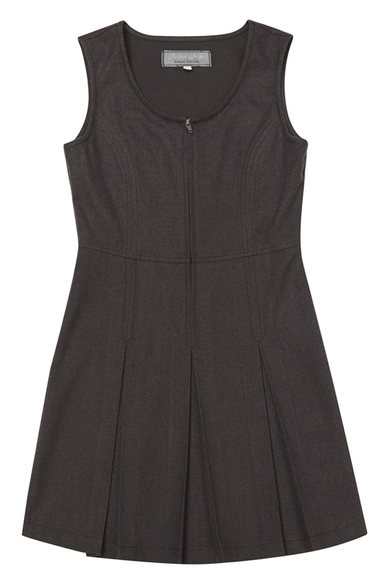
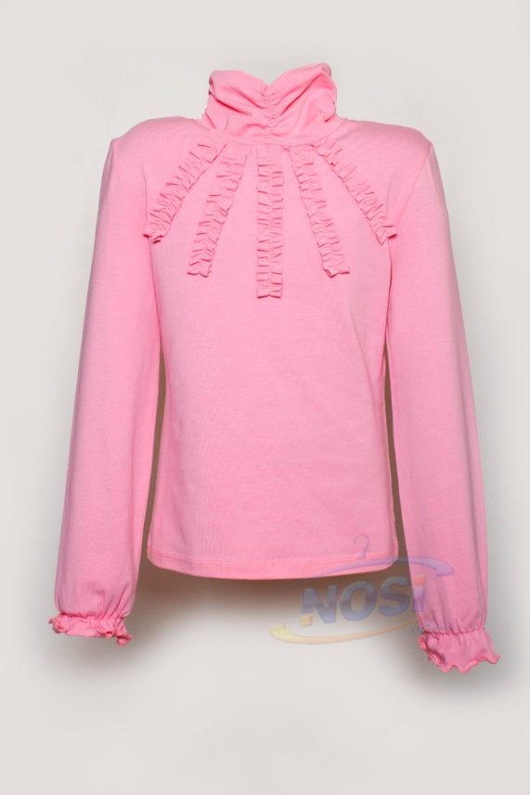
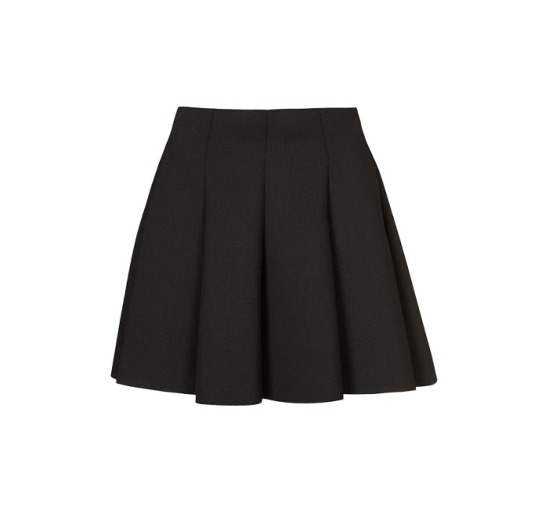
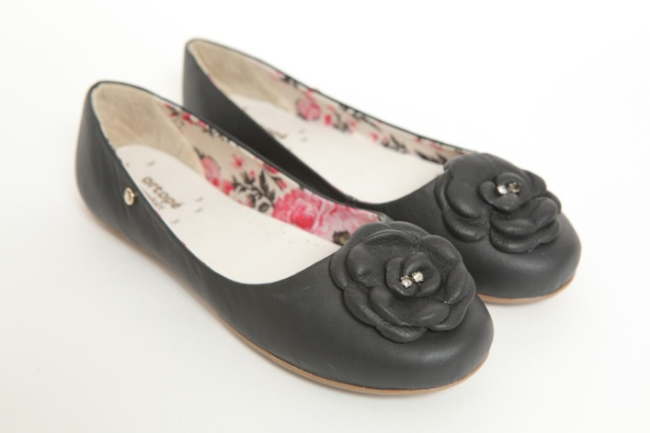
I have not got many clothes but there are my favourite. If I go to school I put on a uniform: school sundress or skirt, blouse and shoes.

Slide 3
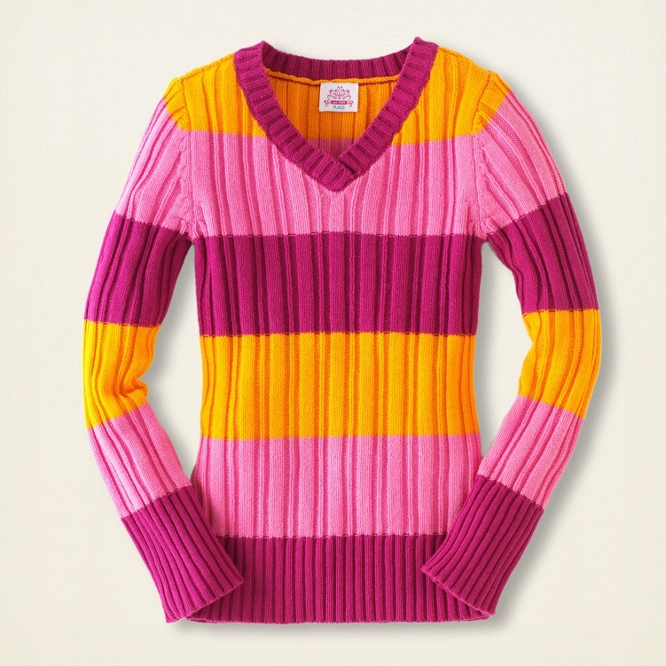
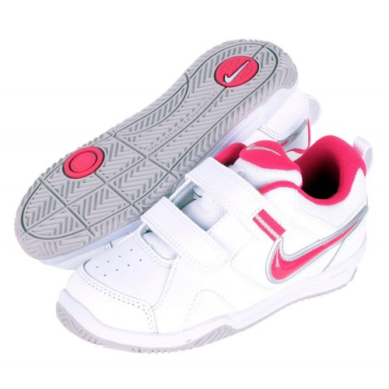
I wear jeans, sweater and trainers when I go for a walk.

Slide 4
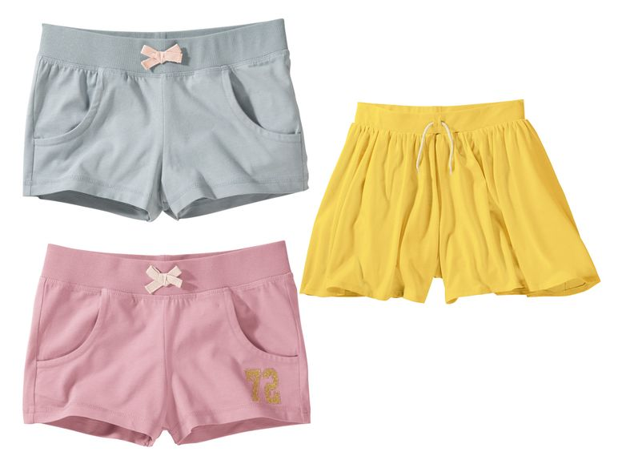
At home I wear a T-shirt and shorts.

Slide 5
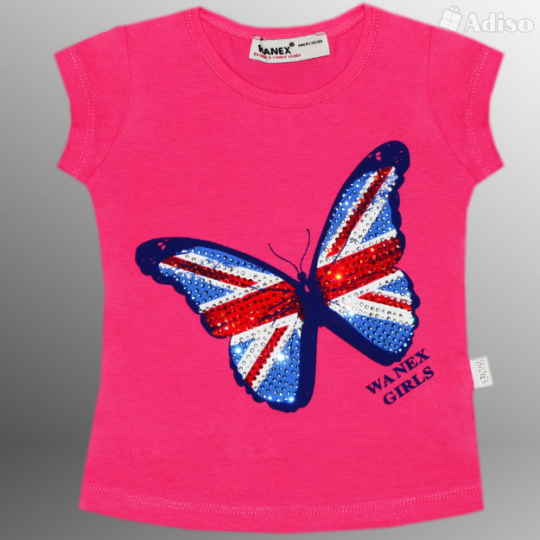
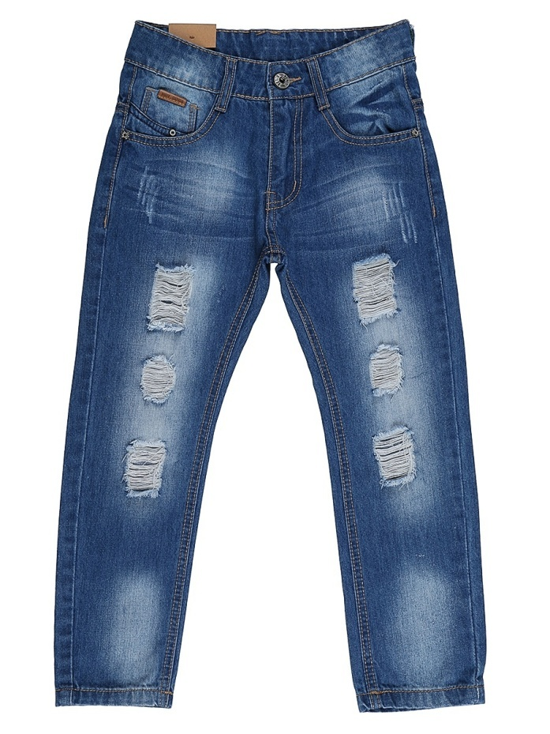
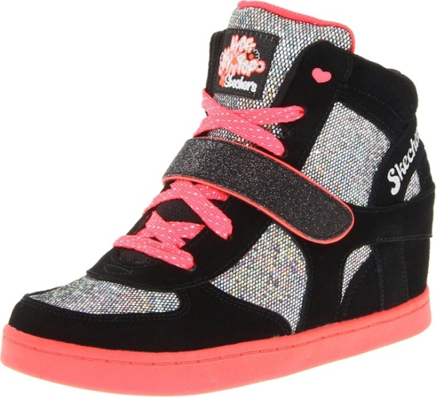
At the party I can put on jeans, T-shirt and boots

Slide 6
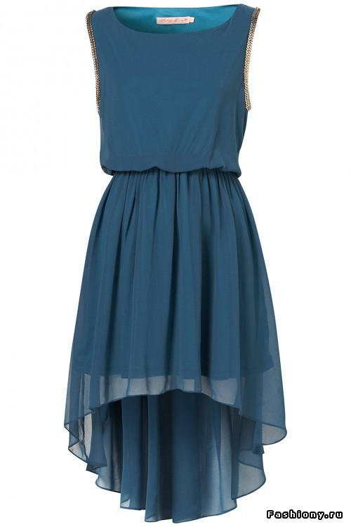
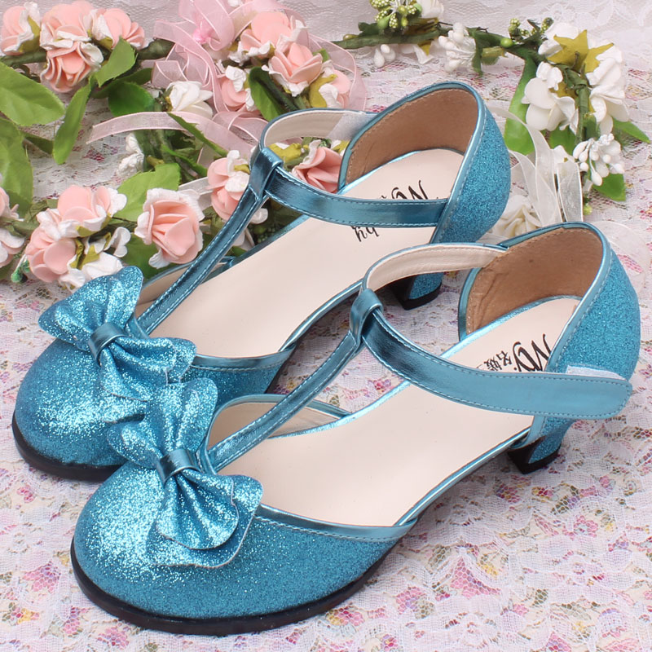
or a beautiful dress and shoes.

Slide 7
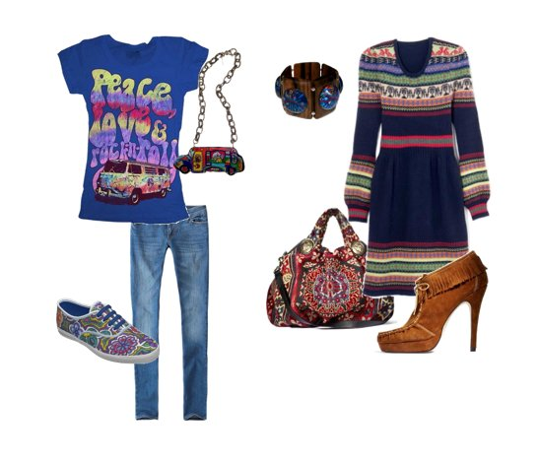
I think clothes must be clean and comfortable. I like wearing smart things.

