Slide 1
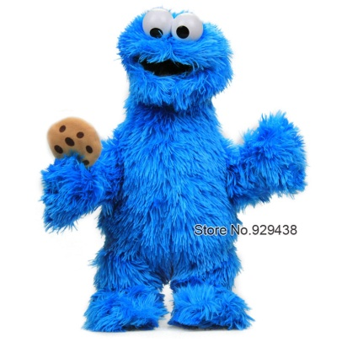
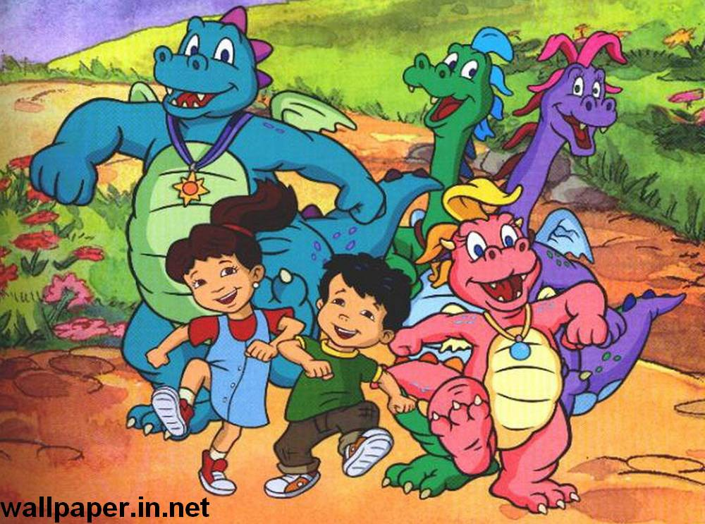
Cassie is not a monster!
Lesson 11 (по Кузовлеву)
Class 2

Slide 2
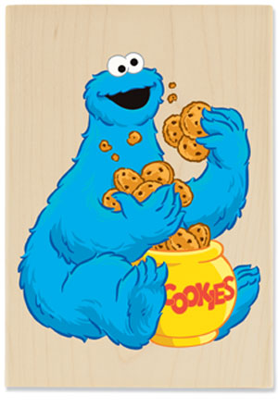
Cookie is not yellow. He is blue.

Slide 3
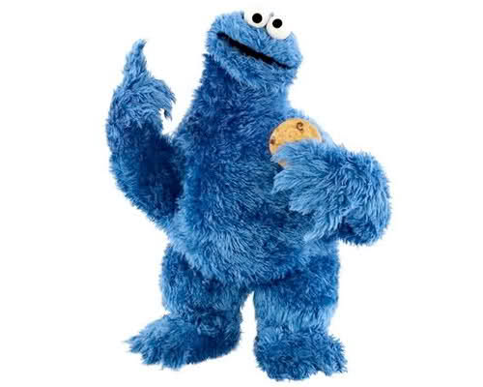
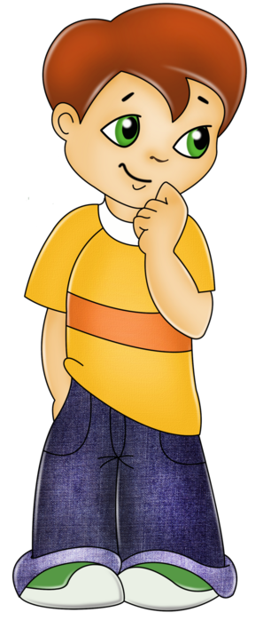
He is a monster.
He is not a monster.

Slide 4
He is a not small monster.

Slide 5
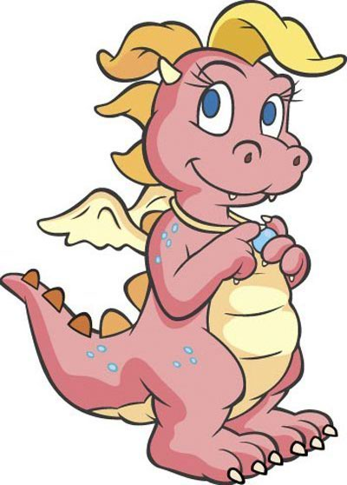
Cassie is pink. She is not red dragon.

Slide 6
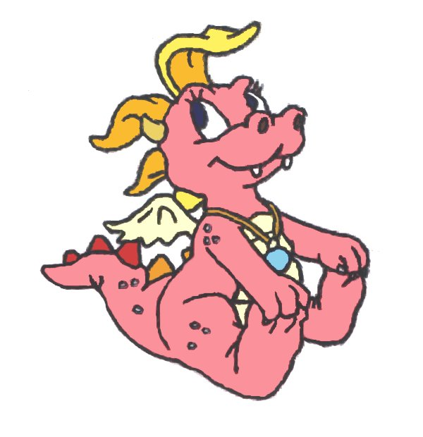
And she is not a big dragon.

Slide 7
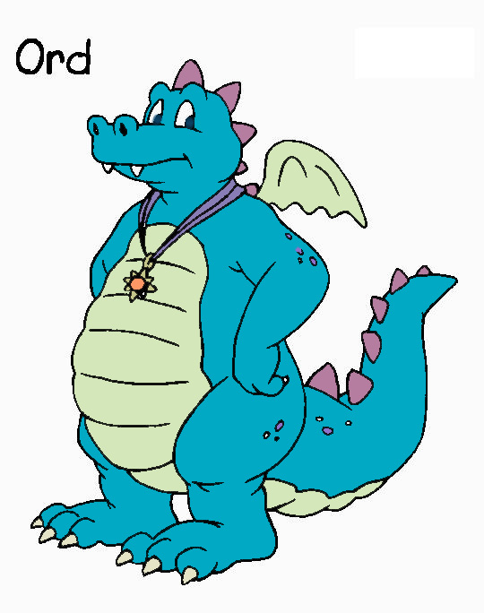
Ord is big blue dragon. He is kind.

Slide 8
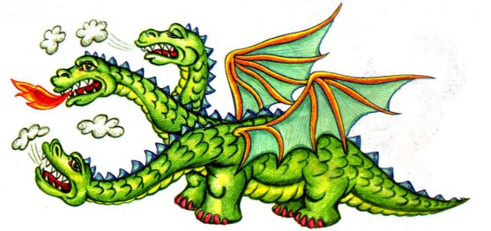
Dragon is big and green. He is evil.

Slide 9
is big\ small. He isn’t blue\ green. kind\ evil. a dragon\ a monster.

