Slide 1
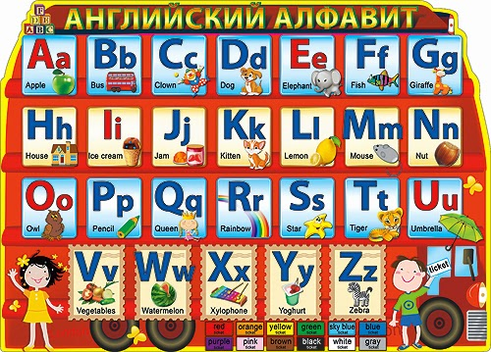

Slide 2
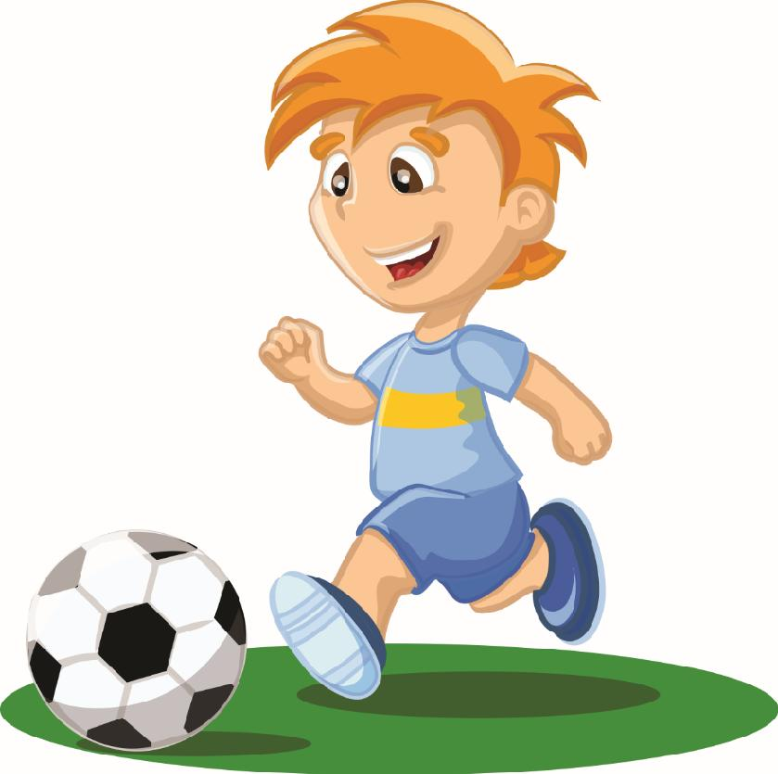
Are you good at football? [ɑː juː gʊd æt ˈfutbɔːl]

Slide 3
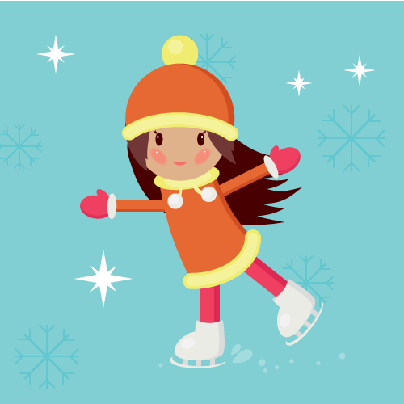
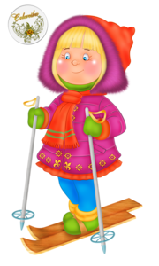
«In winter I ski and skate,»
Says little Kate.

Slide 4
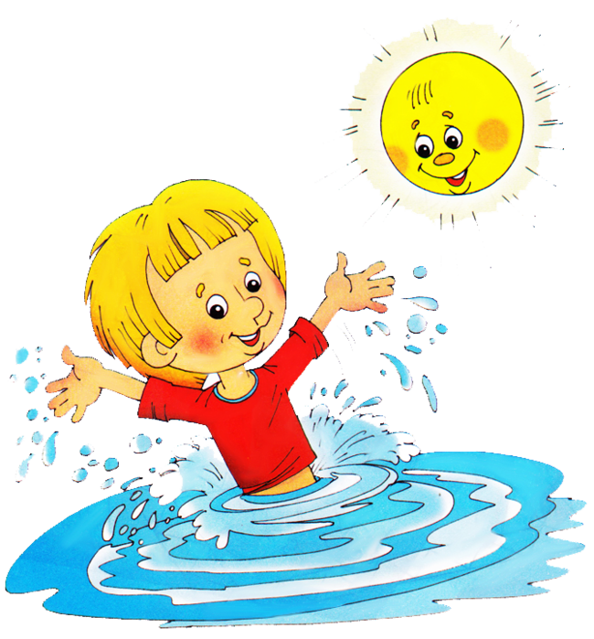
«In summer I like to swim,»
Says little Jim.

Slide 5
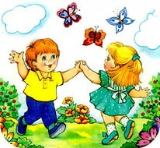
And what do you like to do in spring?
In spring we dance and sing.

Slide 6
«In winter I ski and skate,»
Says little Kate.
«In summer I like to swim,»
Says little Jim.
And what do you like to do in spring?
In spring we dance and sing.

Slide 7
Winter mascots (Russia)

Slide 8
Are you a winter mascot? – Ты талисман зимних игр?
Guess! – Отгадайте!
Are you good at skating? – Ты хорошо умеешь
[ɑː juː gʊd æt ˈskeitin]
No, I’m not.
Are you good at swimming?
Yes, I am.
You are a summer mascot!
Yes, I am.

Slide 9
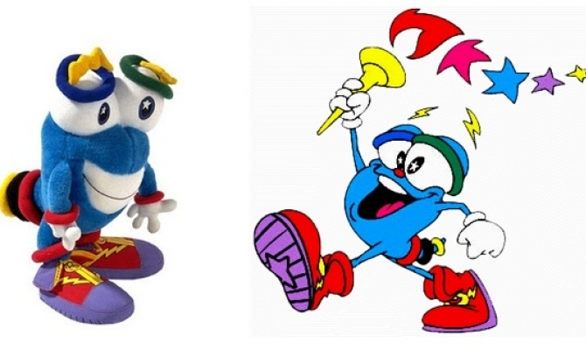
Summer mascot (America)
I am not good at skating.
[ai æm not gʊd æt skeitɪŋ]
I am a summer mascot.
[ai æm ə sʌməˈmæskət]
I am good at swimming.
[ai æm gʊd æt swɪmɪŋ]
Izzy

Slide 10
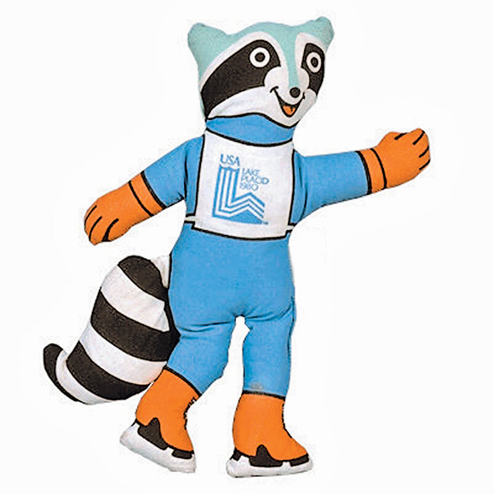
Winter mascot (America)
Rony is a raccoon.
[roni iz ə rəˈkuːn]
He is from America.
[hi iz frɒm əˈmerɪkə]
He is good at winter
sports.
He is a winter mascot.
Rony

Slide 11
Summer mascots (Australia)
They are from Australia.
[ðeɪ ɑː frɒm ɒsˈtreɪlɪə]
They are good at
summer sports.
They are summer
mascots.

Slide 12
Are you good at football? [ɑː juː gʊd æt ˈfutbɔːl]

Slide 13
Thank you for the lesson!

