Slide 1
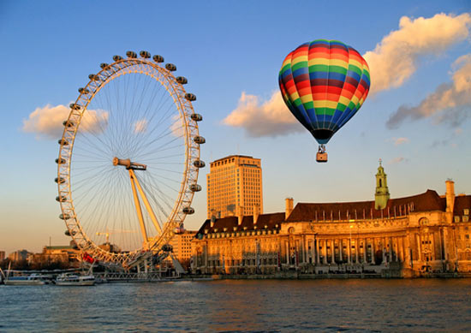
Лондонский глаз
London Eye

Slide 2
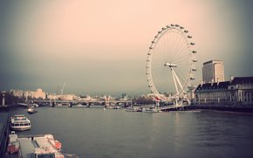
The London Eye - one of the largest Ferris wheel in the world, located in the London district Lambed on the south bank of the Thames.
With a height of 135 meters (about 45 floors) overlook almost the entire city. Ferris wheel - the project architect David Marks and Julia Barfield, who won the design competition in honor of the buildings of the new millennium. Implementation of projects took six years.

Slide 3
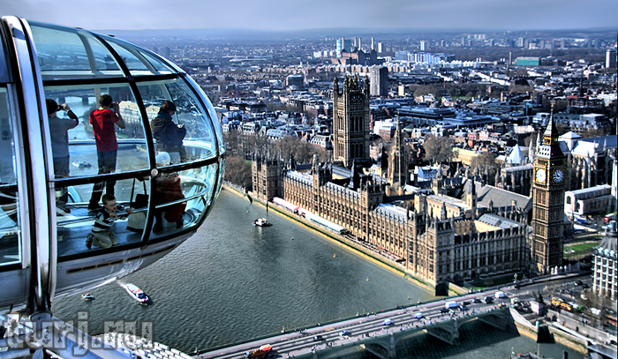
Design and construction
The London Eye has 32 fully enclosed and air-conditioned cabins for passengers capsules made in the shape of an egg. The capsules symbolize the 32 suburban London. Each 10-ton capsule can accommodate up to 25 passengers. The wheel is rotated at a constant speed of 26 centimeters per second (about 0.9 kilometers per hour) to one revolution takes approximately 30 minutes. .

Slide 4
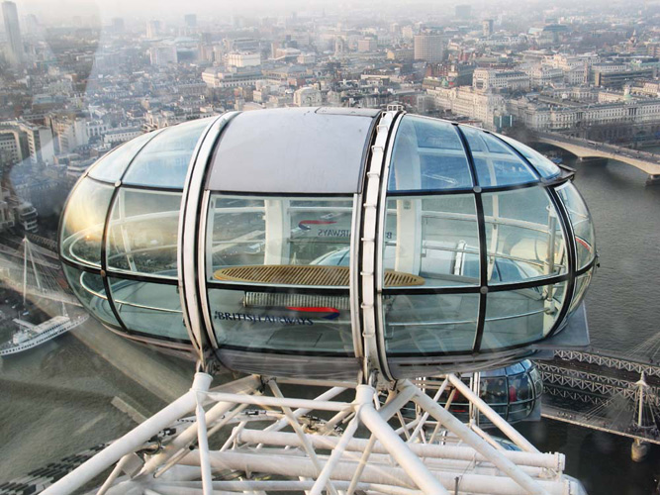

Slide 5
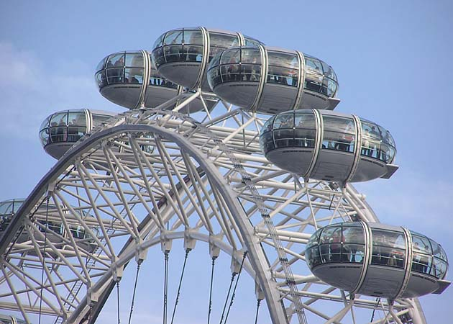

Slide 6
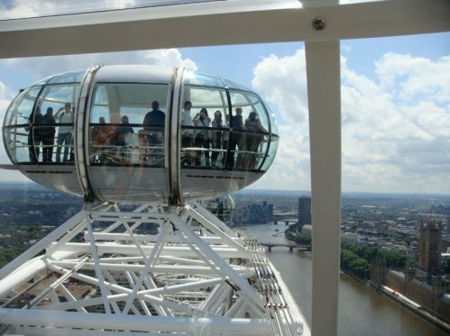

Slide 7
history
.
The formal opening of the London Eye chaired by Prime Minister Tony Blair, December 31, 1999, but for technical reasons, it was opened to the public only in March 2000. Since opening it has become the most popular attraction and each year it is visited by about one million tourists. And it turned into a place of urban and public holidays.

Slide 8
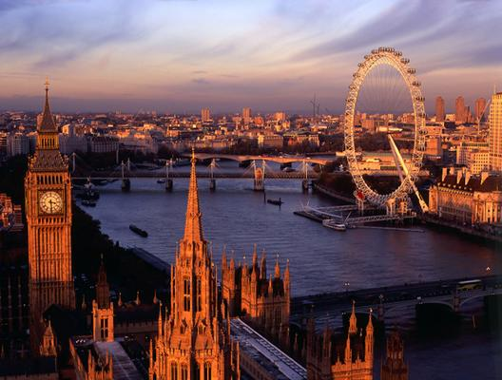

Slide 9
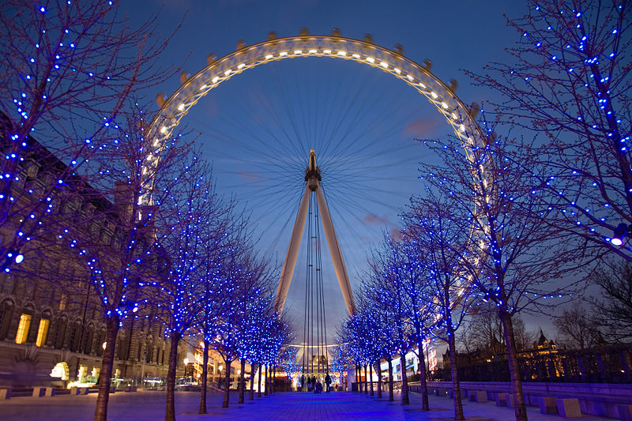

Slide 10
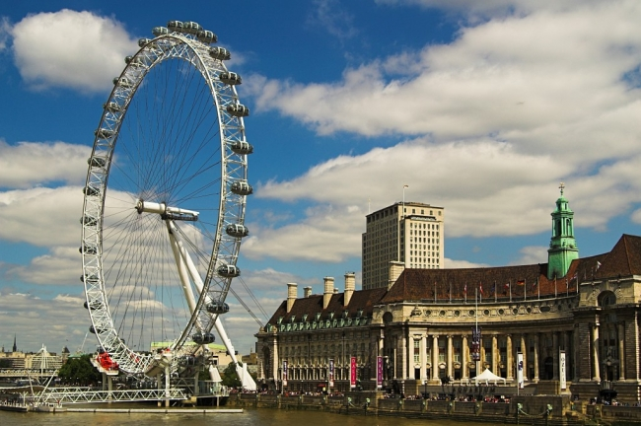

Slide 11
