Slide 1
Animals I like.
Made by Aliakbarov Airat
Form 6

Slide 2
I have of course a lot of favorite animals, but among them there are three animals whom I love the most.

Slide 3
My first favourite animal is a horse. I like this animal because it is a very kind, faithful and beautiful.

Slide 4
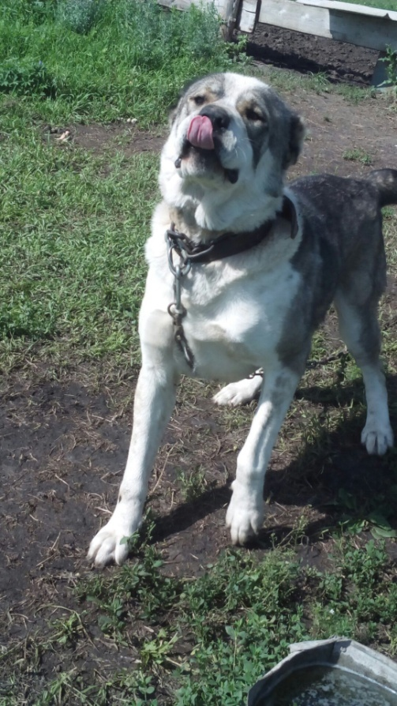
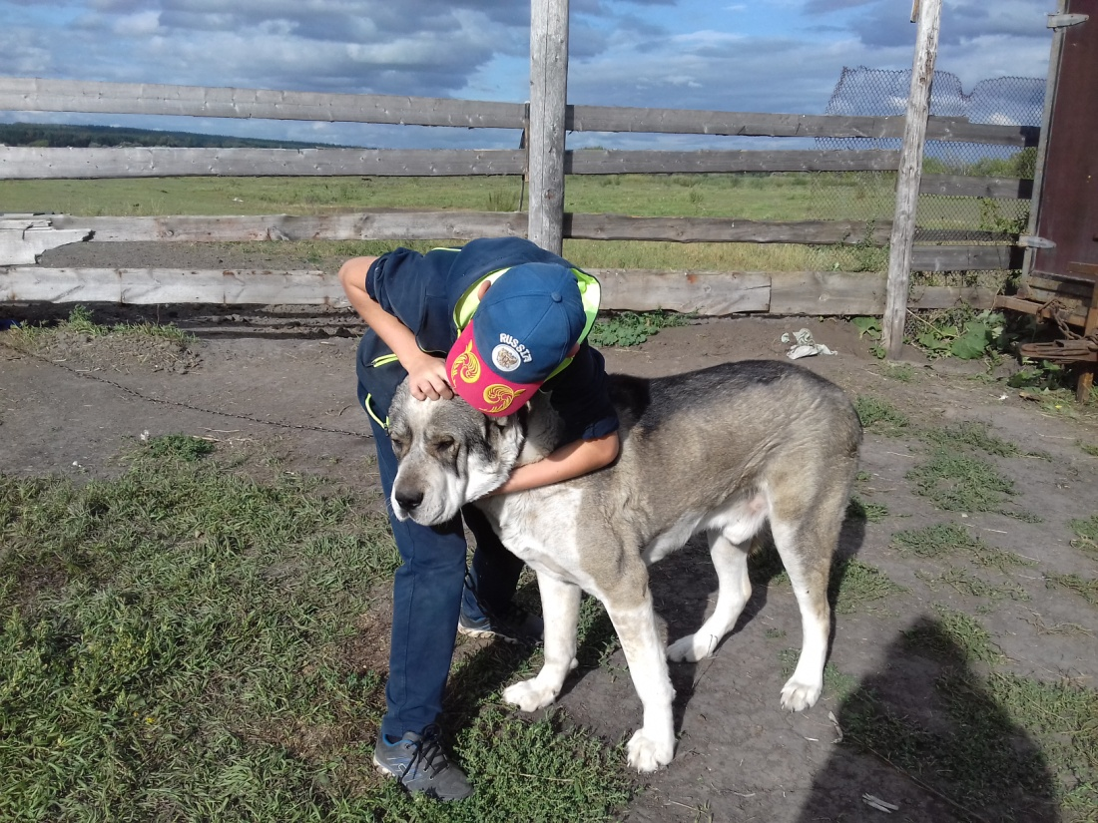
My second favourite animal is a dog. I like my dog because he is loyal, smart and playful.

Slide 5
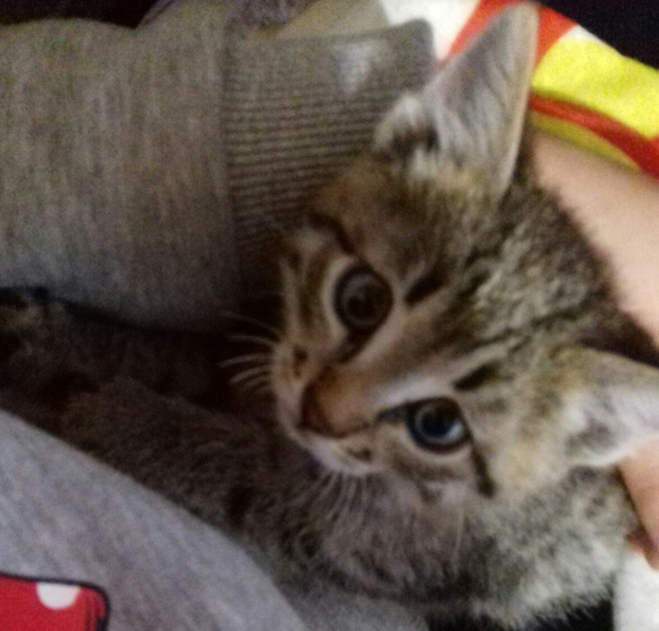
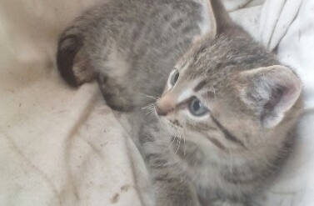
My third favourite animal is a cat. I like his because he's cute, nimble and fluffy.

Slide 6
So I talked about my favorite animals. Animals are our friends, without them we will be sad, they help us to be more kind and considerate of everything living.

Slide 7
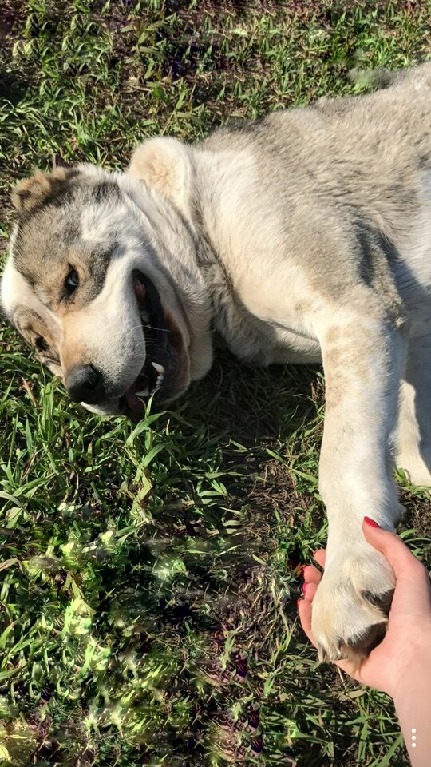
Thank you for attention!

