Slide 1
PROJECT My best day
Bibikova Ksenia
2016

Slide 2
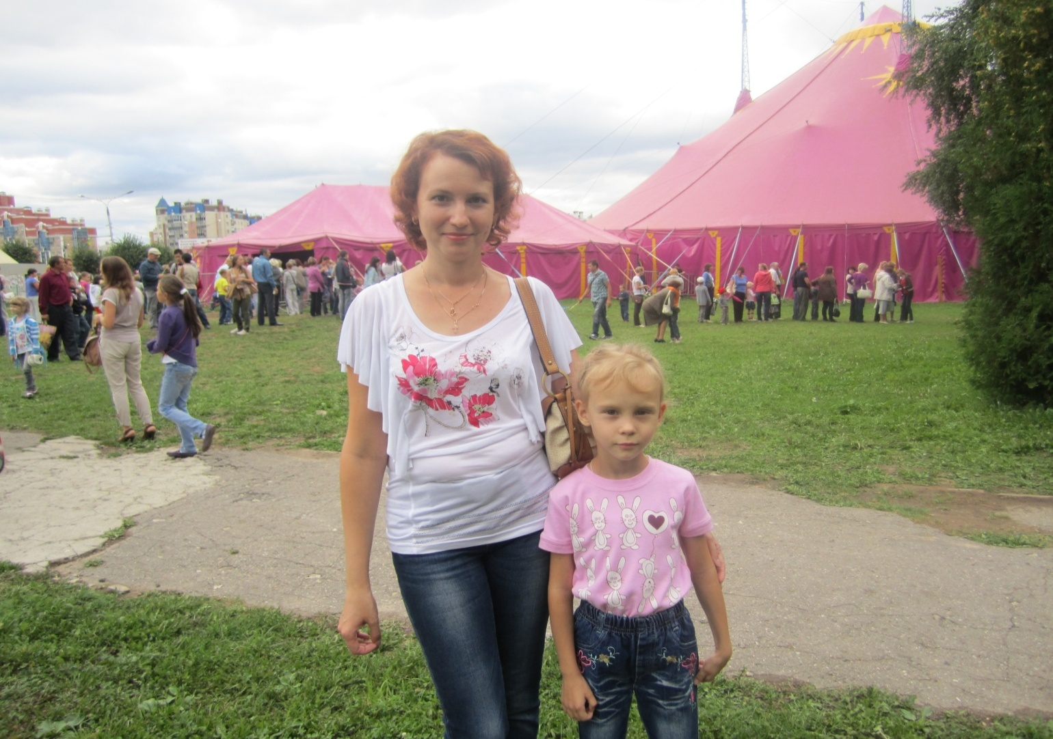
While we was in Cheboksary I and my family had visited the circus on the water.

Slide 3
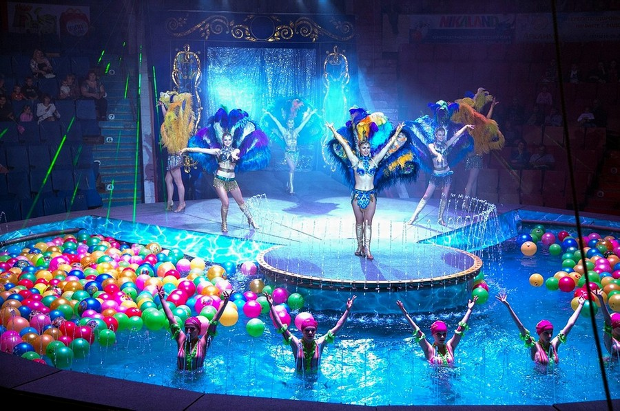
This was no ordinary circus, but a performance. The arena consisted of two parts: the stage and the pool.

Slide 4
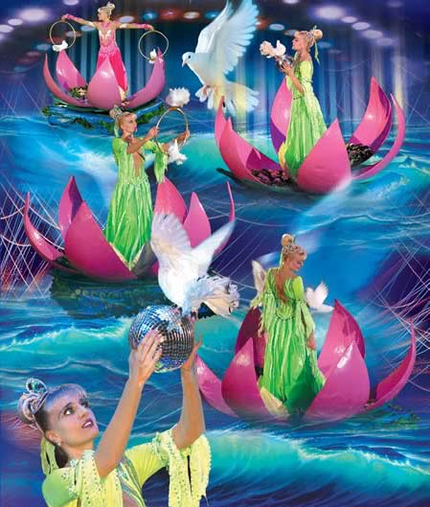
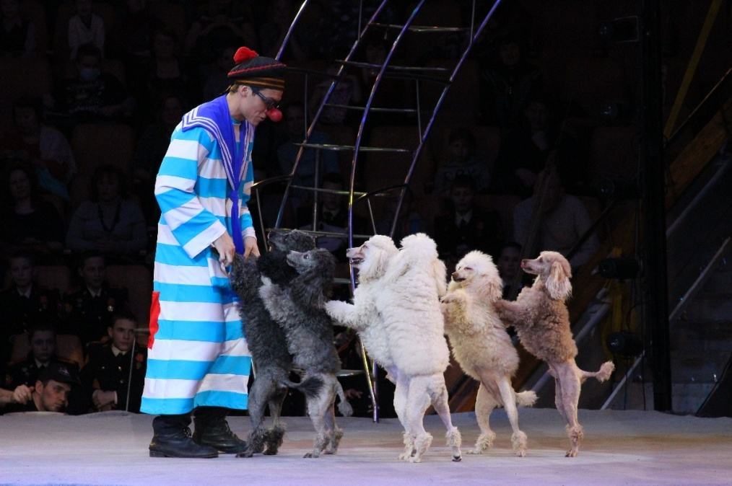
The performance aerial acrobats were accompanied with water dancing synchronized swimmers.

Slide 5
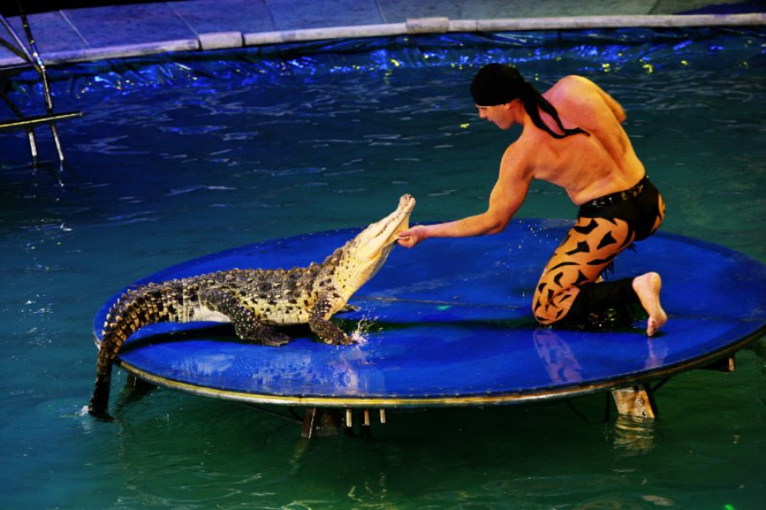
So we were able to see not only trained cats, pigeons, dogs, monkeys, and crocodile, sea lion, and even python.

Slide 6
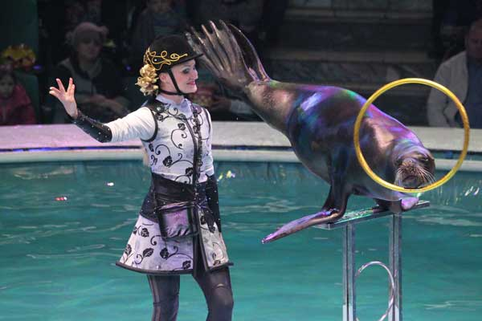

Slide 7
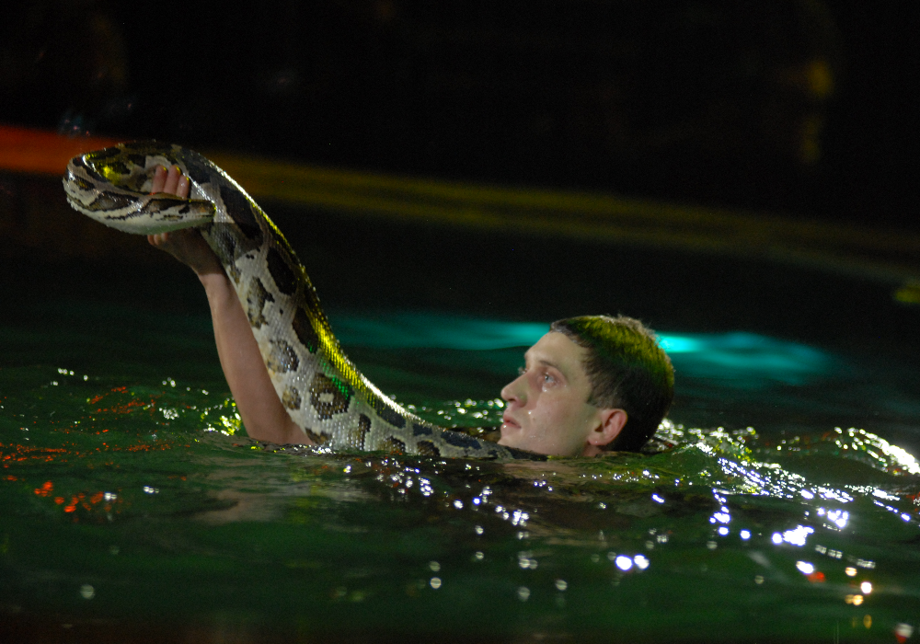

Slide 8
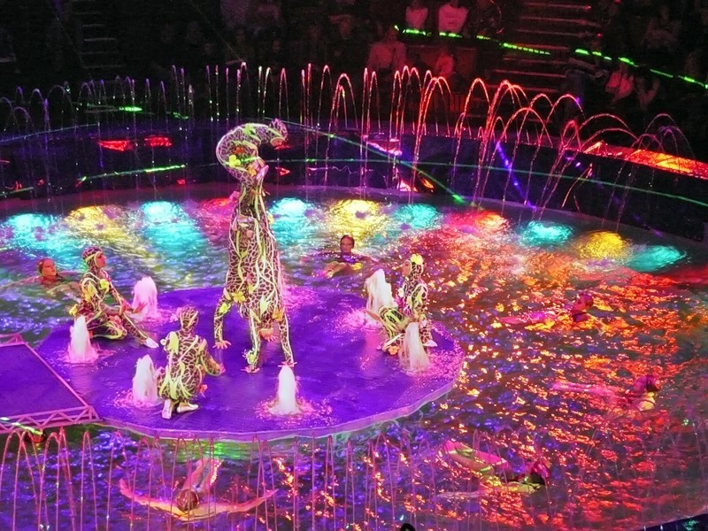

Slide 9
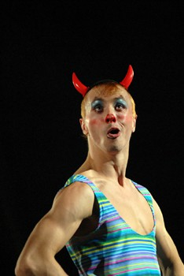
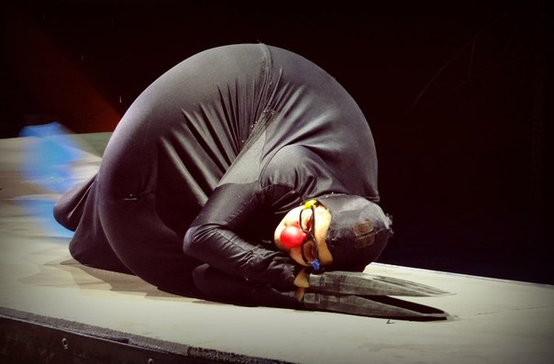
Funny clown were appeared on stage with every number, helping with props, it is distracting the audience with his jokes.

Slide 10
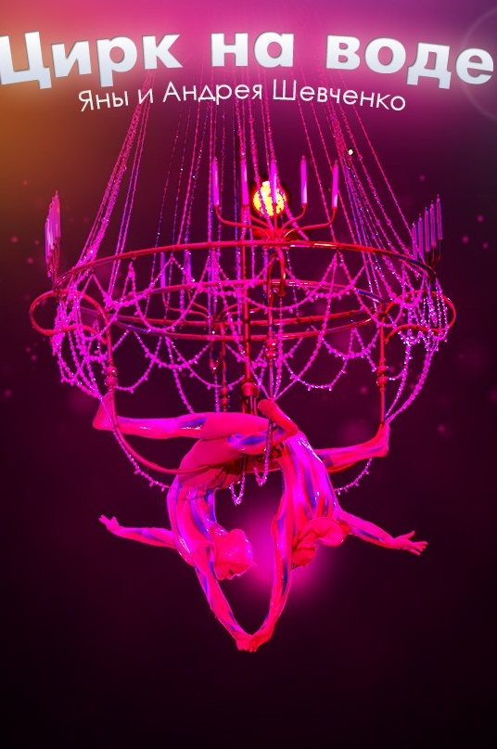
For memory we bought the CD with the show on the water and now when I want to remember those wonderful moments, we turn on its again

Slide 11
Thank you for your attention

