Slide 1
What have you done today to stay healthy

Slide 2
Word building
head – голова
ache – боль
head + ache = ?

Slide 3
What’s wrong with these people?
What are the problems?

Slide 4
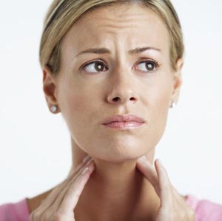
I have a horrible sore throat.

Slide 5
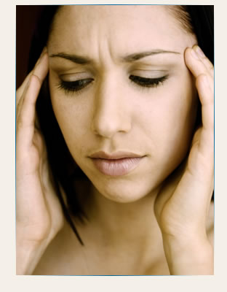
I have a headache.
Perhaps, I have
the flu (грипп).

Slide 6
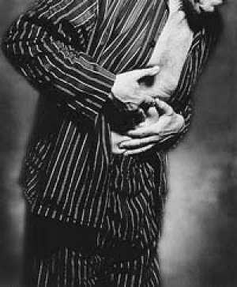
I have a stomachache.
I feel (чувствую) awful.

Slide 7
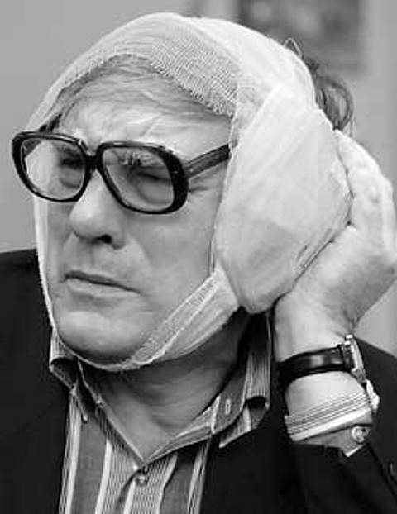
I have horrible earache.

Slide 8
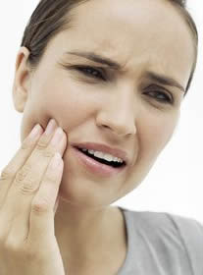
I have toothache.
It’s horrible.

Slide 9
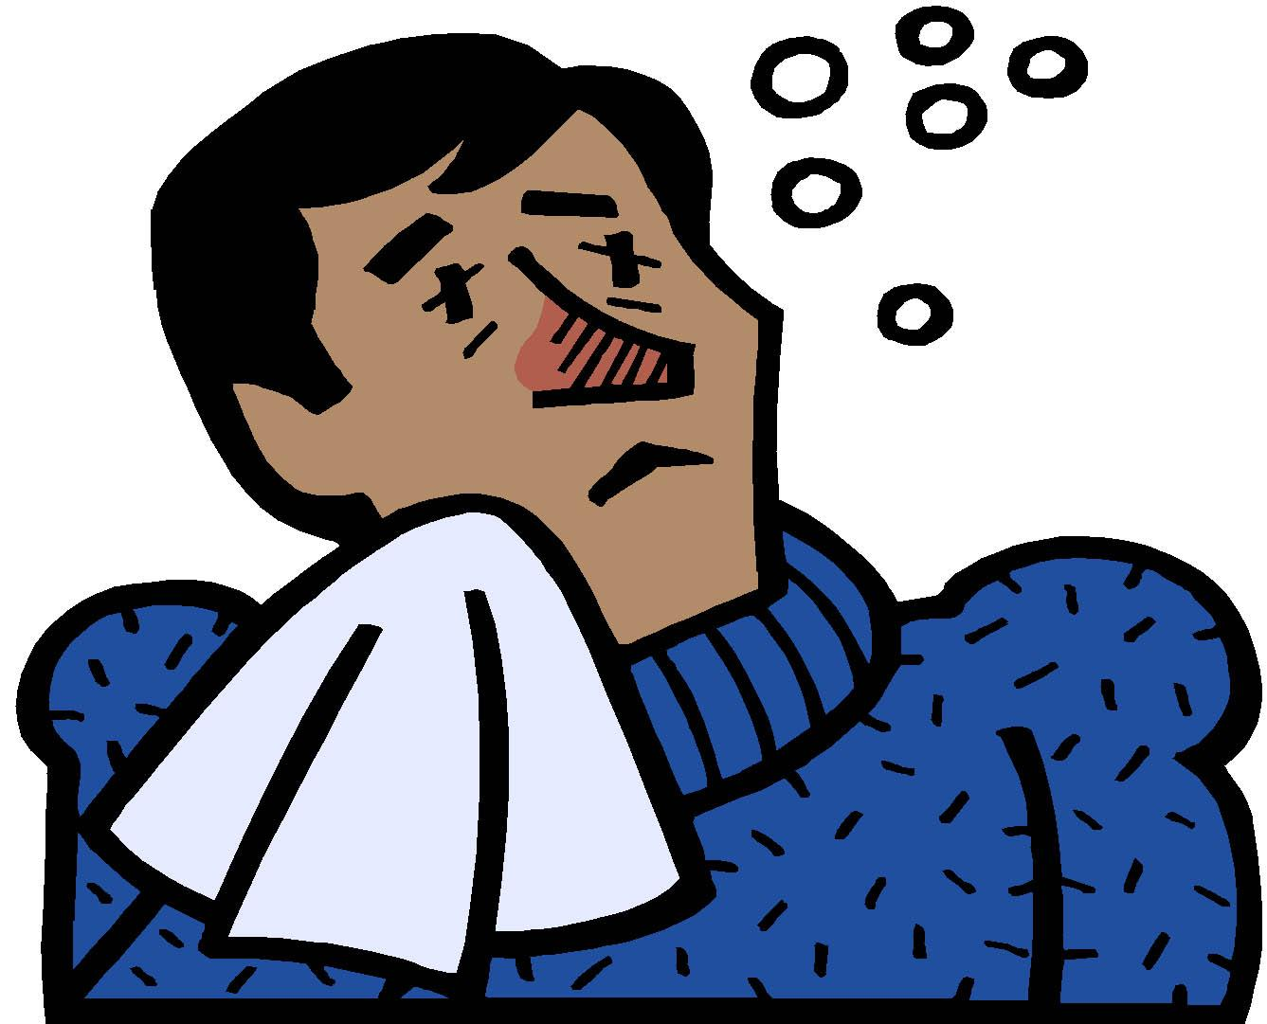
I have a cold (простуда).
I don’t feel well.

Slide 10
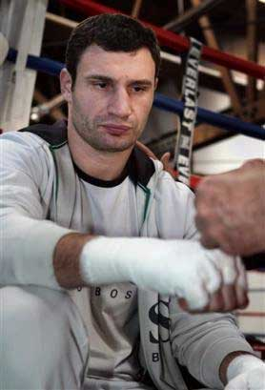
I’ve cut my hand.
It hurts (болит).

Slide 11
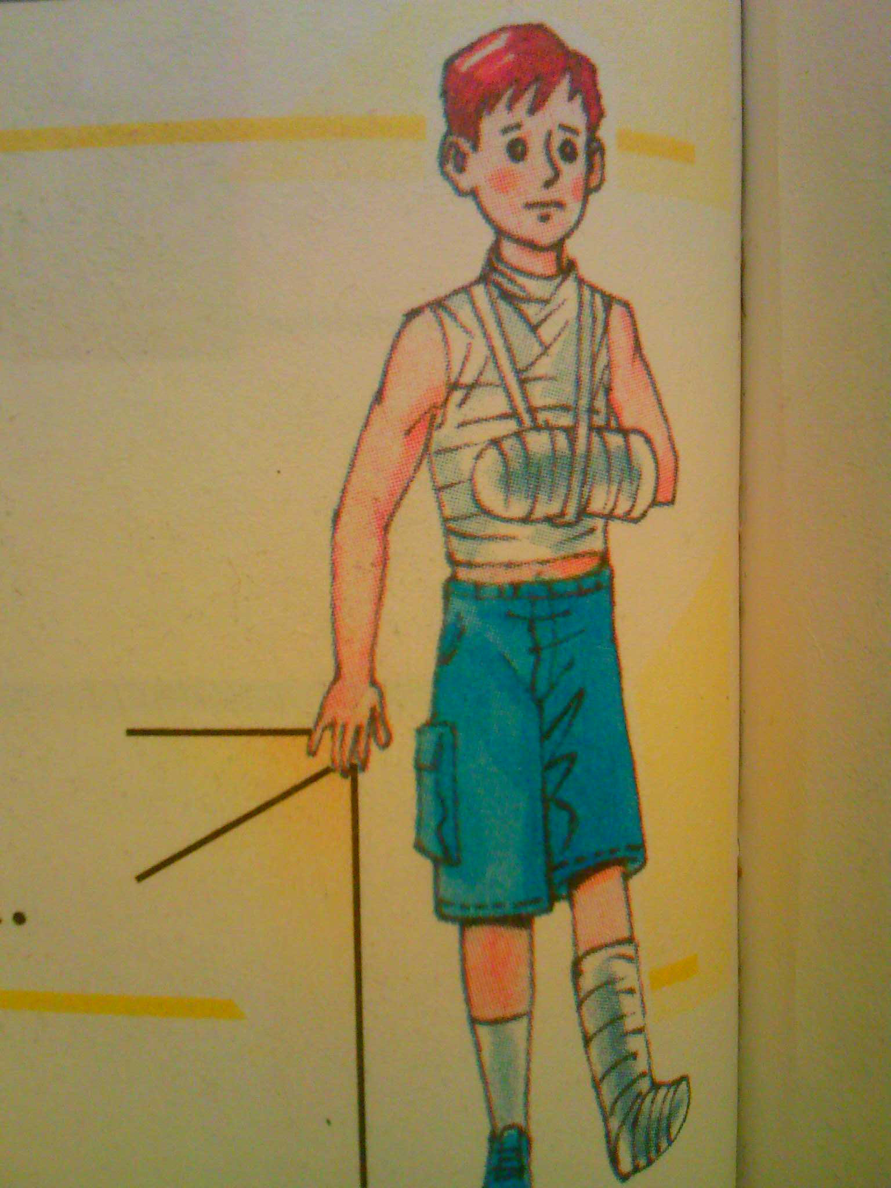
I’ve hurt (повредил) my back, leg and arm.

Slide 12
British English American English
a headache
a stomachache
НО !
earache
backache
toothache
a headache
a stomachache
an earache
a backache
a toothache
In both British and American English:
appendicitis, measles (корь).

Slide 13
Arm – arms, но tooth -teeth
Запомни:
A mouse – mice a man – men
A tooth – teeth a woman – women
A goose – geese a child – children

Slide 14
Choose which of these words are parts of the body and which are illnesses.
1. earache
2. a back
3. toothache
4. legs
5. a stomachache
6. sore throat
7. the flu
8. head
9. teeth
10. a headache
11. a cold

Slide 15
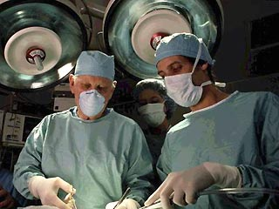
A surgeon

Slide 16
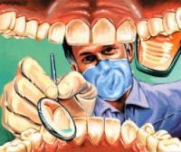
A dentist

Slide 17
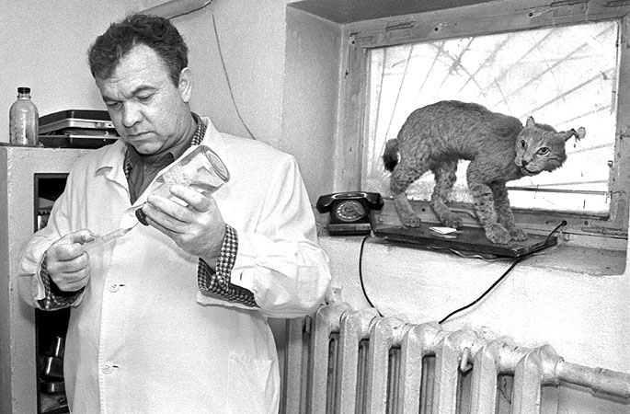
A veterinarian

Slide 18
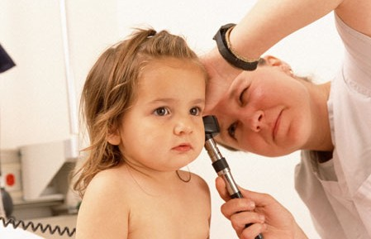
A pediatrician

Slide 19
Proverbs
1 An apple a day keeps the doctor away.
2 Never put off till tomorrow what you can do today.
3 Health is above wealth.
4 Early to bed and early to rise makes a man healthy , wealthy and wise.

Slide 20
Homework
Ex 3. p. 99 (all about me)

