Slide 1
“Highlights of sports”
8 form

Slide 2
It's too rainy for rugby,
Too foggy for football.
It's too icy for hockey,
There'll be no games at all?
Not so. Come hail and tempest,
The master of cunning
Will, with a sly smile, suggest
Some cross country running.

Slide 3
A sound mind in a sound body.
Talent wins games, but teamwork
and intelligence wins championship.
In sports and journeys men are known.
All for one and one for all.
Талант добывает победу в игре, но чемпионство
добывают команда и интеллект.
Один за всех и все за одного.
Люди познаются в спорте и в путешествиях.
В здоровом теле здоровый дух.

Slide 4
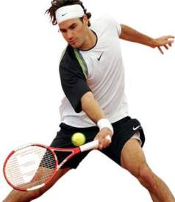
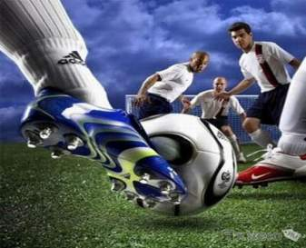
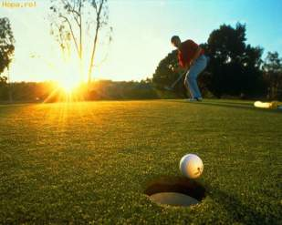
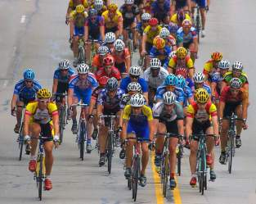
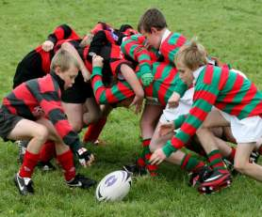

Slide 5
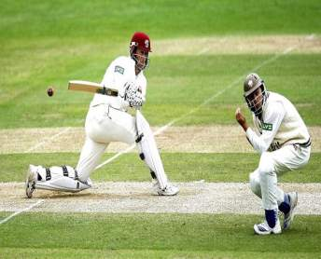
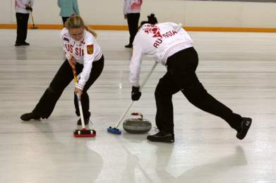
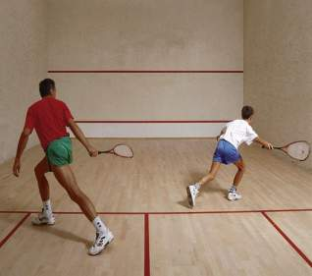
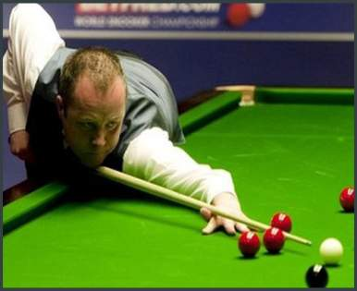

Slide 6
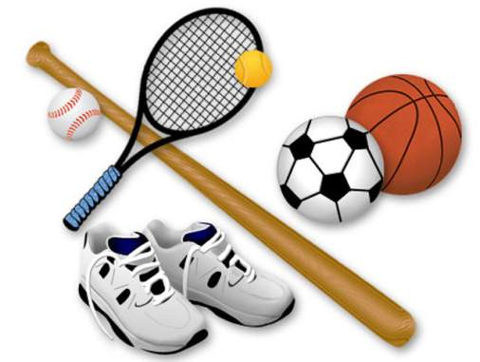
Name 5 games where you can hit the ball
(with various kinds of equipment).
Name 4 games where you can pass the ball.
Name 3 games where you catch the ball.
Name 2 games where you can kick the ball.
Name 1 game where you can hit the ball with your head.

Slide 7
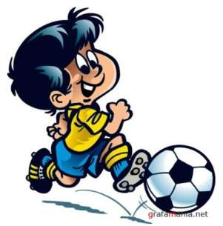
Do the crossword!
… stays in the goal.
… trains the team.
… attacks the goal and scores.
… protects the goal.
… controls a football match.

Slide 8
Tell us the kind of sport
these sportsmen are good at.
Elena Berezhnaya, Anton Sikharulidze, Evgeni Plyushchenko
Vyacheslav Fetisov, Alexandr Ovechkin, Evgeni Malkin
Gaidarbek Gaidarbekov, Nikolai Valuev
Maria Sharapova
Arsen Glstyan
Alia Mustaphina, Alina Kabaeva
Elena Isinbaeva
Ekaterina Gamova
Sergei Ignashevich, Alexandr Kerzhanov, Alexei Berezutski

Slide 9
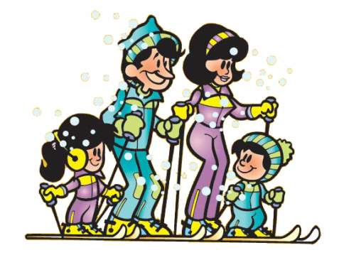
Sports builds character
It teaches you about life
Sport makes men out of boys
Sport helps people to become good friends
Sport helps to meet people
It teaches you to win and to lose
It teaches you to be disciplined

Slide 10
Homework.
Projects on topic “SPORT”

