Slide 1
«An apple a day keeps the doctor away.»
Made by pupils of 6 form Bibikova Arina and
Bashkirova Inessa.

Slide 2
Habits
Bad
Good

Slide 3
Food
healthy
unhealthy
-Fruit
-Fish
-Juice
-Honey
-Nuts
-Meat
-Sweets
-Cakes
-Coca-Cola
-Snacks

Slide 4
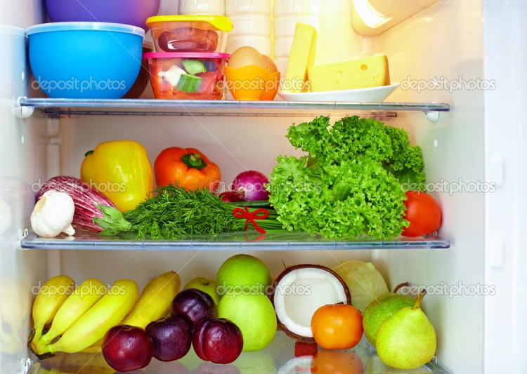
What do we do when we want to be healthy?
You should!
1) Eat the right foods
2) Sports
You shouldn't!
1)You should not eat fast food
2) You shouldn't smoke,can't drink alcohol

Slide 5
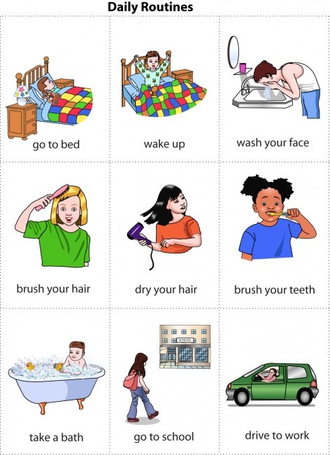
Schedule of the day
You need to respect your day!

