Slide 1
a good proverb
Tastes differ.

Slide 2
Appearance
Height (рост):
tall, short, big, small
1 metre ['mі׃tә] 20 centimetres ['sentImі׃tәz]
Build (телосложение):
plump slim

Slide 3
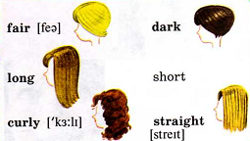
Face:
round, oval
Hair:

Slide 4
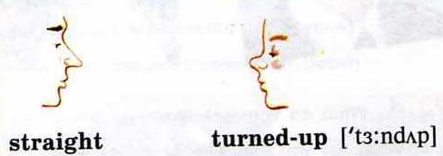
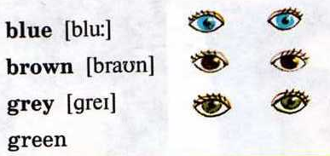
Nose:
Eyes:
Mouth:
big, small

Slide 5
Extra information:
beautiful , attractive
handsome [' hænsәm] красивый
pretty ['prItI] хорошенькая
good – looking красивый, приятный
ugly некрасивый

Slide 6
Let’s look at the pictures. I hope you can answer the questions.
Is she tall?
Is she slim?
What is her hair like?
What is her face like?
What are her eyes?
What is her nose like?
What is her mouth like?
What does she look like?

Slide 7
Let’s read the text.
We’ve got a new girl in our class.
Oh, really? What’s her name?
Jane.
How old is she?
She’s 11 years old.
What does she look like? Is she pretty?
Oh, yes. She’s really good-looking. She’s got long dark hair and large blue eyes.
Is she tall?
No, she’s short and slim.
Where did she come from?
Her family came from another city. I forgot its name.

Slide 8
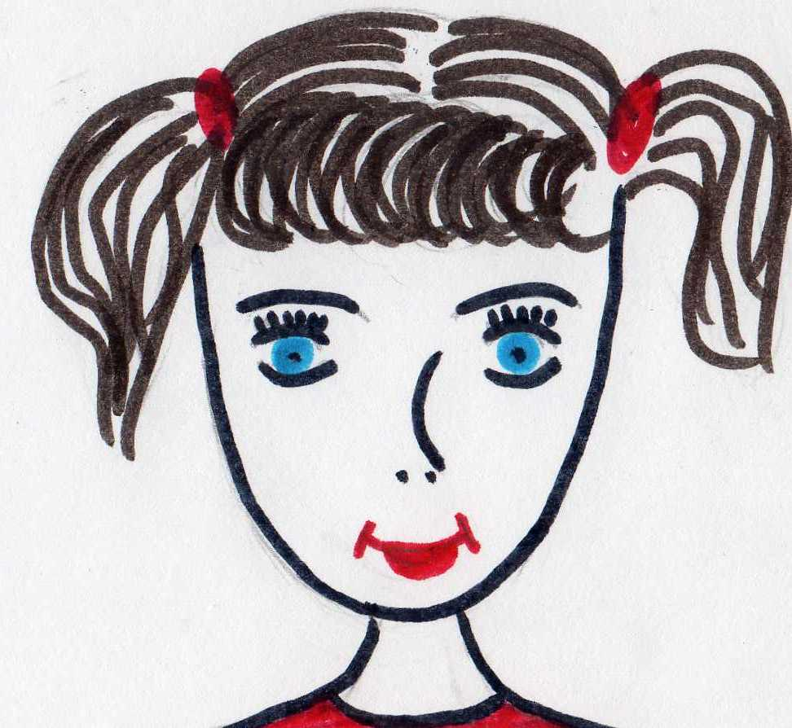
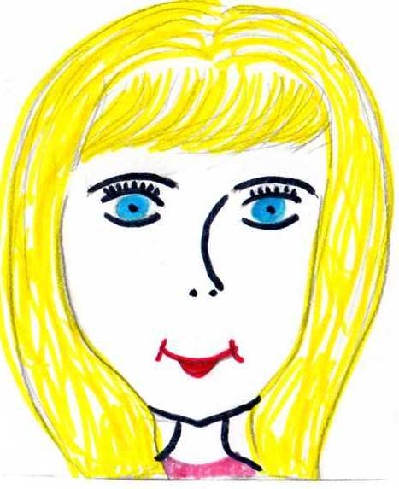
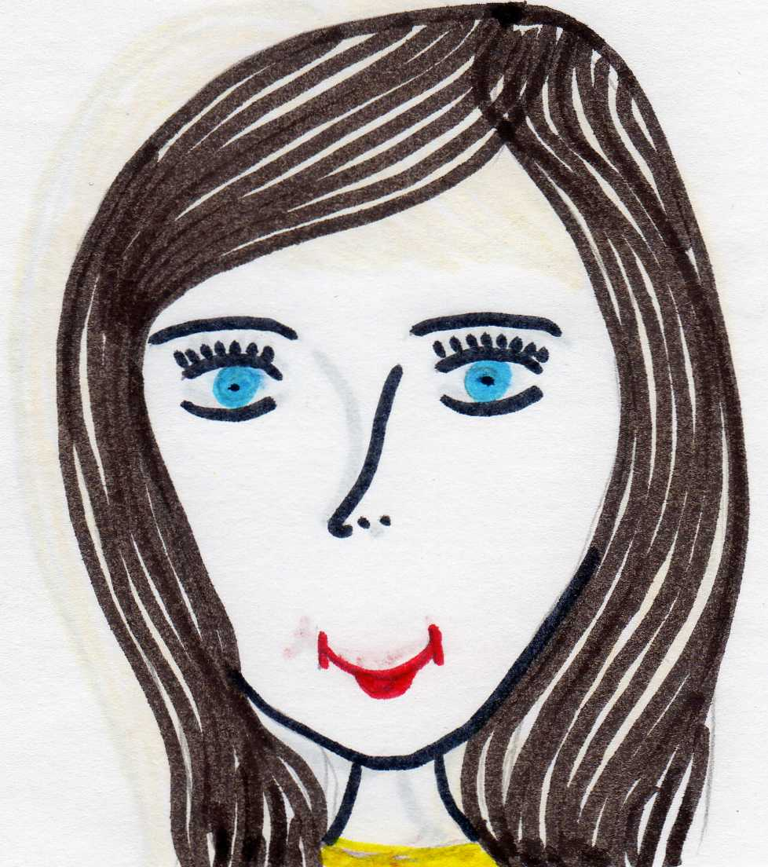
I’m sure you can guess Jane’s photo.

Slide 9
Actually you can answer the questions.
What does Jane look like?
Is she tall and slim?
What is her hair like?
What are her eyes like?
Let’s know what you learn about Jane.
Try to describe Jane.

Slide 10
What about you?
Answer the questions.
What is your height now?
What colour are your eyes?
What colour is your hair?
How long is your hair?
What is your nose like?
What is your face?

Slide 11
Possessive Case (Притяжательный падеж)
В английском языке, в отличие от русского языка, существительные имеют притяжательный падеж, который служит для того, чтобы сказать, кому что принадлежит. Форму притяжательного падежа имеют в основном одушевленные существительные, обозначающие живое существо, которому принадлежит предмет, качество или признак. Например :
the girl’s book – книга девочки
the boys’ dictionary – словарь мальчиков
children’s books – книги детей
Притяжательный падеж существительных в единственном числе образуется путем прибавления окончания – ‘s (т.е. знака апостроф ‘ и буквы s) Tom’s dog
Чтобы образовать притяжательный падеж , к существительному во множественном числе добавляется только апостроф ‘ the girls’ room

Slide 12
Let’s do exercises.
Translate the sentences.
It’s Tom’s room.
It’s my cat’s box.
It’s Fred’s tent.
2.Rewrite the sentences.
For example: This is Pete and his book. – This is Pete’s book.
This is Jim and his dog. – This is …
This is Tom and his jug. – This is …
This is Max and his mug. – This is …
This is Nick and his book. – This is …
3.Translate into English.
Это комната папы.
Это кружка мамы.
Это кровать Пита.

Slide 13
Homework:
Learn the words by heart and the proverb.
Complete the table about Jane and speak about her.
Name | Age | Appearance | Hair | Eyes | Height | Build

