Slide 1
WHAT GAMES DO YOU PLAY?
Do you play sports?
Yes, I do.
Where do you play sports?
At school. After school I play games with my brother.
What games do you play?
Computer games and football.
Tim
Kirk

Slide 2
Vocabulary
where
what games
to have fun
how often
why
what
when
где
(в) какие игры
веселиться
как часто
почему
что
когда

Slide 3
Вопросительное предложение
I
we
you
they
When
How often
Why
Where
speak English?
Do
he
she
it
Does
speak English?

Slide 4
Where do you roller-skate?
How often do you watch TV?
The Sims.
Every day.
Why do you watch TV every day?
Football
My toys.
Where do you swim?
What do you like painting?
In the lake.
What games do you play?
It’s interesting.
Near our house.
What sports do you play?

Slide 5
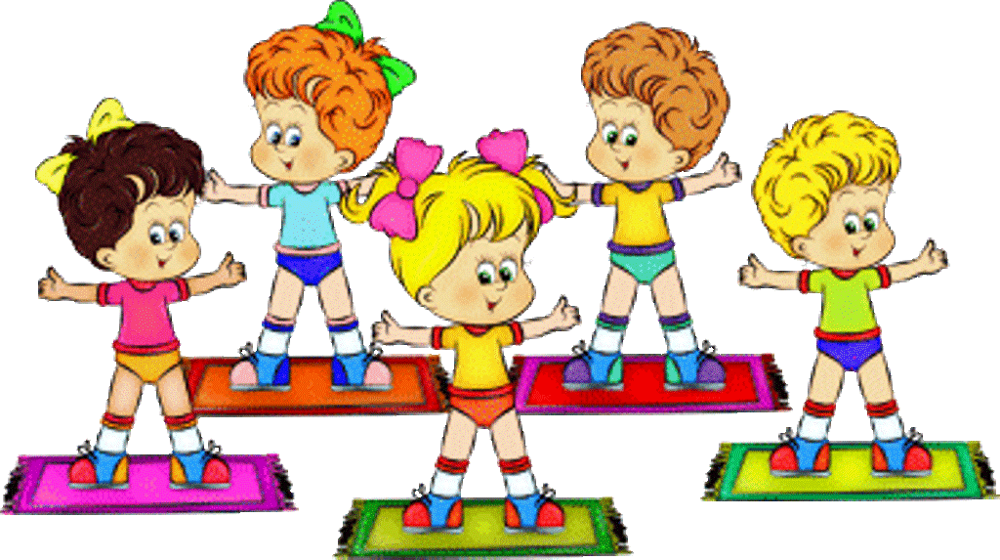
Let’s sing and dance!

Slide 6
When Where When What games
…… do you usually swim?
Where
In winter I swim in the swimming pool. In summer I swim in the lake.
And I swim in the river in summer. …… do you go to the swimming pool?
When
I usually go there on Mondays and Fridays.
… … do you like?
What games
I like football. My father and I watch every football match.
When
… do you usually go to the park?
On Saturdays and Sundays.
Tim
Kirk

Slide 7
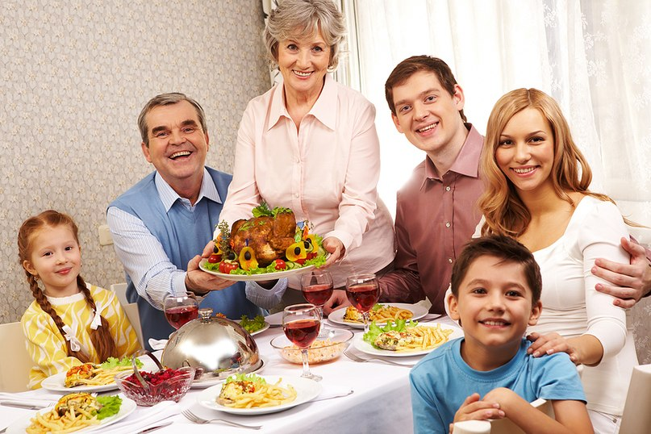
Let’s play “ At the Kirk’s”
(Ex. 3 p. 32)
Who will be Kirk?
Ask him questions.

Slide 8
Составь предложения
on TV? / do / watch / you / What
What do you watch on TV?
ride? / you / What / do
What do you ride?
do / What games / you / like playing?
What games do you like playing?

Slide 9
Составь предложения
your mother / What / cook / does
What does your mother cook?
help / your parents? / you / do / How often
How often do you help your parents?
do / play / you / When / sports?
When do you play sports?

Slide 10
Homework
Упр. 6 стр. 32

